Slide 1
Software Testing

Slide 2
Why Testing and Analysis?
Software is never correct no matter which developing technique is used
Any software must be verified.
Software testing and analysis are:
important to control the quality of the product (and of the process)
very (often too) expensive
difficult and stimulating

Slide 3
Real life examples
First U.S. space mission to Venus failed. (reason: missing comma in a Fortran do loop)
December 1995: AA, Boeing 575, mountain crash in Colombia, 159 killed. (Incorrect one-letter computer command)
June 1996: Ariane-5 space rocket, self- destruction, $500 million. (reason: reuse of software from Ariane-4 without recommended testing).

Slide 4
Testing Strategies
SW testing is one element of a broader topic referred to as V&V (many SQA activities).
Verification (correctly implement specific function)
Defect detection and correction
Comparison between implementation and the corresponding specification
Are we building the product right?
Validation (SW is traceable to customer requirements)
Defect prevention
Provision of sound basis for specific design decisions
Are we building the right product?
Example: Checking the printing of receipts is verification and correct printing (info) is validation.

Slide 5
Types/Strategies of testing
Code Inspections
Software (Module) Testing
Unit Testing
Functional Testing
Integration Testing
Compliance
Interoperability Testing
System Testing
Recovery
Security
Load / Stress
Acceptance Testing
Stress, Security, performance, Load Testing etc

Slide 6
Software Testing
Objectives (different for each type)
it does what it should ---- requirements conformance
it does it well and efficiently ------ performance
it does so without error ------ errors-correctness
And so on ------ an indication of quality
Carefully designed and coded program - less chances of errors but some always exist.
To some people: ”A process of checking a program to show there are no errors”- implies that a successful testing is one that shows no error.
This a wrong approach. The aim of testing is to find errors so that they can be corrected.

Slide 7
Software Testing
A better definition: ”the process of running software with the intent of finding an error”.
The way most testing works is to input a set of values, then compare the expected result with the out comes/computed ones.
Depending on the type of data input, we can identify three levels of program correctness possible, probable, and absolute correctness.

Slide 8
Three Levels of Correctness
Possible correctness
Obtaining correct output for some arbitrary input (single set).
If the outcome is wrong, the program cannot possibly be correct.
For example a multiply program: for input 2 and 3, if
result is 6; is possibly correct.
Probable correctness
Obtaining correct output for a number of carefully selected inputs.
If all potential problematic areas are checked in this way, the program is probably correct.
Try several values, including the obvious “problem” values such as zero, largest negative, 1, -1 and so on.

Slide 9
Absolute correctness
can be demonstrated only by a test that involves every possible combination of inputs.
Requires huge amount of time; it is therefore not practical
{However for some programs we can prove correctness mathematically}.
Imagine the same above test for a 32 bit machine (how many combinations are possible? (Hundreds of Millions).

Slide 10

Testability
Which S/W is testable? Characteristics of a testable S/W.
Operability —it operates cleanly
Observability —the results of each test case are readily observed
Controllability —the degree to which testing can be automated and optimized
Decomposability —testing can be targeted
Simplicity —reduce complex architecture and logic to simplify tests
Stability —few changes are requested during testing
⬥ Understandability —of the design

Slide 11

Test case design
"Bugs lurk in corners and congregate at boundaries ..."
OBJECTIVE ---- to uncover errors
CRITERIA ----- In a complete manner
Boris Beizer
CONSTRAINT ------ with a minimum of effort and time
A successful test -- -- that uncovers an as-yet undiscovered error.
Minimum number of required tests with 100% functional coverage and 0% redundancy.
Rich variety of test case design methods
- Cause-effect graphing, Equivalence Class Partitioning, Boundary Analysis, and vendor specific: client/server, OO test case design.
Possible approaches:
Knowing the specified functions, tests can be conducted to demonstrate that each function is fully operational (Black Box).
Knowing the internal workings of a product, tests can be conducted to ensure that “all gears mesh“ (White Box).

Slide 12
Why bother with white box testing?
Black box testing:
Requirements fulfilled
Interfaces available and working
But what about
the internal structure of a component,
interactions between objects?
white box testing
FURTHER
Logical errors and incorrect assumptions are inversely proportional to the probability that a program path will be executed.
Sometime a path executes counterintuitive.
Typographical errors are random.
Also: if black box testing finds error, locating it is easier with additional white box testing!

Slide 13
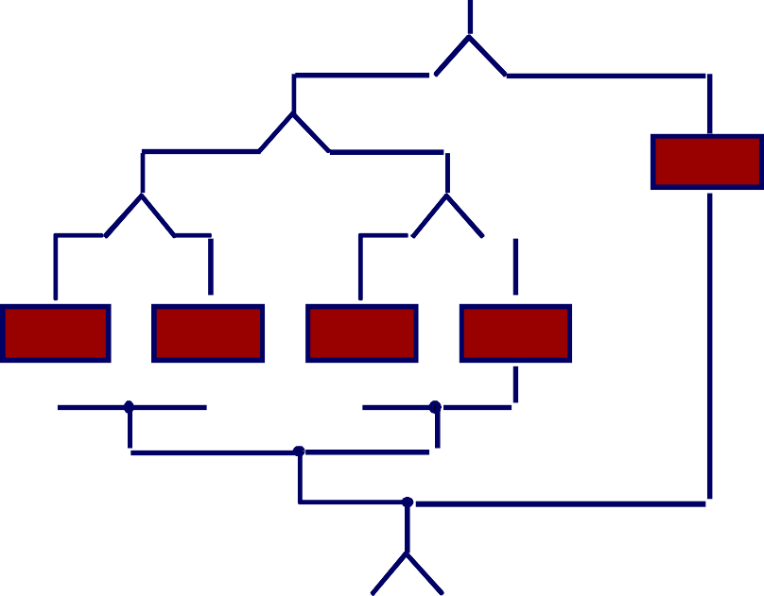
Exhaustive Testing
loop 20
loop 20
There are 10 ¹⁴ possible paths ! If we execute one
test per millisecond, it would take 3,170 years to test this program!!

Slide 14

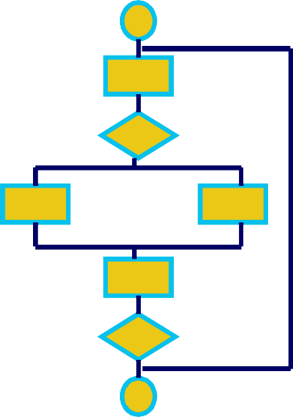
White-Box Testing
... our goal is to ensure that all statements and conditions have been executed at least once ...

Slide 15
White-Box
White box testing, sometimes called glass-box and structural testing.
Various aspects like Statement Coverage Criteria, Edge coverage,
Condition Coverage, Path Coverage are defined mathematically and test set is designed accordingly.
There are no algorithms for generating white box test data. However the check list might help:
Has every line of code been executed at least once by test data.
Have all default paths been traversed at least once.
Have all significant combinations of multiple conditions been identified and
Have all logical decisions exercised on their true and false sides.
Have all loops executed at their boundaries and within their operational bounds.
Have internal data structures validated▪

Slide 16
Basis Path Testing: A White Box technique
This method enables the designer to derive a logical complexity measure of a procedural design and use it as a guide for defining a basis set of execution paths.
Guarantees to execute every statement in the program at least once.

Slide 17
Basis Path Testing
FLOW GRAPH Notation (nodes, links)
Each circle (node) represents One or more non-branching PDL or source code statements)
Sequence If
While (for)
Case
Until (do-while)
An arrow (link) represents control flow.

Slide 18
Nodes, Edges, And Regions
Each circle is a node (represents one or more procedural statements -- sequence of process boxes and a decision diamond can map into a single node)
A conditional node is called a predicate node
Arrows are called edges and must terminate at a node.
Areas bounded by edges and nodes are called regions (including the area outside the graph)

Slide 19

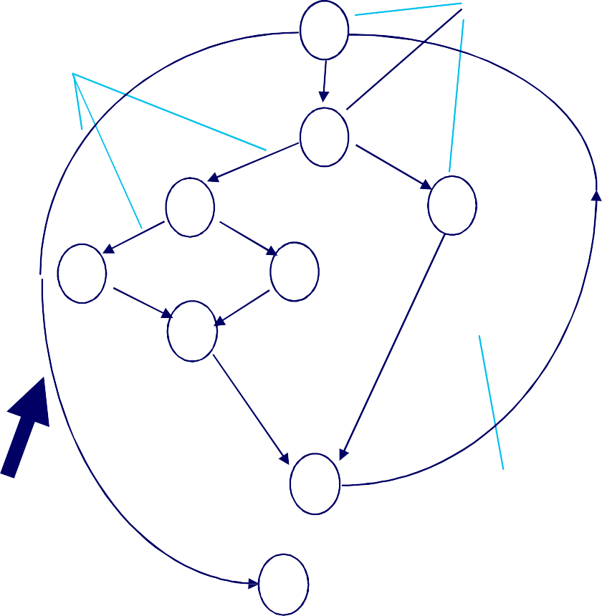
Flowchart And Flow Graph
Node
1
1
Edge
2,3
2
6
R₂
4,5
3
7
R₃
9
8
R₁
6
4
7
8
5
9
10
Region
10
11
R₄
11

Slide 20
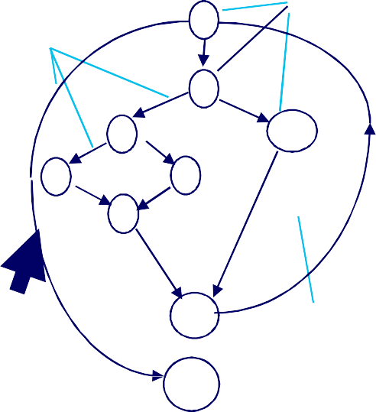
Cyclomatic Complexity
Cyclomatic complexity provides a quantitative measure of the logical complexity of a program
– It is the number of tests that must be conducted to assure that all statements have been executed at least once
Cyclomatic complexity, V(G) is given by:
Edge
(1) V(G) = E - N + 2
1
Node
2,3
where E is the number of edges and N
number of nodes (11-9 +2 = 4)
V(G) = P + 1, where P is the number of predicate nodes (3+1 = 4)
V(G) = number of regions (4)
6
7 R₃
9
R₂
4,5
8
R
1
10
Region
R₄
11

Slide 21
Independent Paths
The value for cyclomatic complexity defines the number of independent paths in the basis set of a program
An independent path is any path through the program that introduces at least one new set of processing statements or a new condition
An independent path must move along at least one edge that has not been traversed before the path is defined
A set of independent paths for a flow graph composes a basis set.

Slide 22

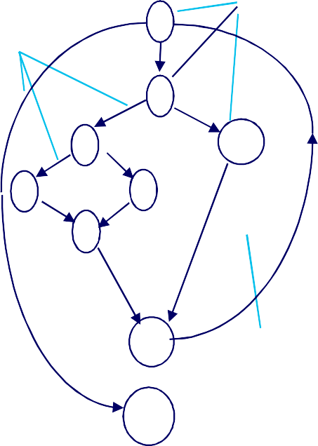



Deriving Test Cases
Using the design or code, draw a corresponding flow graph
you don't need a flow chart,
1
Node
Determine the cyclomatic complexity (even without developing flow graph: count each simple logical test (compound tests as 2 or more) + 1
Edge
2,3
R
2
6
7 R₃
9
4,5
8
R₁
Determine a basis set of paths
Prepare test cases that will force execution of paths in the basis set
basis path testing should be applied to critical modules
10
Region
11
R₄
Exercise: Read and understand the example (Figure 17.4 Pressman5th –450, 6th – Fig

Slide 23
Basis Path Testing
derive the independent paths:
1
2
Since V(G) = 4, there are four paths
3
4
Path 1: 1,2,3,6,7,8
Path 2: 1,2,3,5,7,8
Path 3: 1,2,4,7,8
Path 4: 1,2,4,7,2,4,...7,8
5
6
7
derive test cases to exercise these paths.
8

Slide 24
Control Structure Testing: Loop
Nested Loops
Simple loop
Concatenated Loops
Unstructured Loops

Slide 25
Loop Testing: Simple Loops
Minimum conditions—Simple Loops
skip the loop entirely
only one pass through the loop
two passes through the loop
m passes through the loop m < n*
(n-1), n, and (n+1) passes through the loop
*where n is the maximum number of allowable passes

Slide 26
Loop Testing: Nested Loops
Nested Loops
Start at the innermost loop. Set all outer loops to their minimum iteration parameter values.
Test the min+1, typical, max-1 and max for the innermost loop (while holding the outer loops at their minimum values).
Move out one loop and set it up as in step 2, holding all other loops at typical values.
Continue this step until the outermost loop has been tested.
Concatenated Loops
If the loops are independent of one another then treat each as a simple loop
else
treat as nested* loops
endif

Slide 27
Theoretical Foundation of Testing
Mathematical model: Let P be a program, and let D and R denote its input (Data) and output (Result) ranges. That is, D is a set of all data that can correctly be supplied to P, and the results of P’s execution, if any, are elements of R.
TEST EXAMPLE : Statement Coverage Criteria: We can use above model to define test as: Select a test set T such that, by executing P for each d (subset of D) in T, each elementary statement of P is executed at least once.
Test Case Design Examples
Number of test cases in a test does not necessarily contribute: To test this incorrect program
If x > y Then
max = x;
else
max = x;
endif;
The test case set [x =3, y= 2; x= 2, y= 3] is able to detect the error. Whereas
Test case set [x=3, y = 2; x =4, y = 3, x = 5, y = 1] is not, although it contains more test cases.

Slide 28
Black-Box Testing
requirements
output
input
events

Slide 29
Black Box Testing
Types of errors regarding functional requirements of software:
-- Incorrect or missing functions
-- Interface errors
-- Error in data structure & external data base access
-- Performance errors
-- Initialization & termination errors
No functional requirements NO Black Box Testing.
Demonstrates that each function is fully operational.
Uncovers different kind of errors than white box testing.
Performed later in the testing process.
-
29

Slide 30
Black box techniques derive a set of test cases that satisfy the following criteria:
Test cases reduce the number of additional test cases that must be designed to achieve reasonable testing
Test cases that tell us something about the presence or absence of classes of errors, rather than errors associated only with the specific test at hand.
Black box techniques can supplement the test cases generated by white box.

Slide 31
How to Design Test Cases?
Equivalence class partitioning
Boundary value analysis
Cause / effect graphing (for combinations of input conditions)
Error Guessing

Slide 32
Equivalence Class Partitioning
Two considerations:
each test case should invoke as many different input conditions as possible in order to minimize the total number of test cases necessary.
one should try to partition the input domain of a program into a finite number of equivalence classes.
Equivalence partitioning uses the idea of equivalence classes.
An equivalence class is a set of data which as for specification is concerned will be treated identically (equivalently). *
Objective is to identify those classes of data, which will cause the module to respond in a different manner from other classes.
This is done by reading the specification and creating a list of
all characteristics of programs (e.g. must be numeric, two
integers are input).

Slide 33
Equivalence Partitioning
user queries
output formats
FnKey input
mouse picks
data
prompts

Slide 34
Identifying Equivalence classes
A key concept in the identification of classes is negation, i.e. If a characteristic is identified as an equivalence class, then one should immediately negate the characteristic in order to find
examples of classes which should cause the
as
module to do something different such
“generate an error message”.
Partitioning each input condition into two or more groups.
Two types of equivalence classes are identified:
Valid Equivalence Classes
Invalid Equivalence Classes

Slide 35
Sample Equivalence Classes
Valid data
user supplied commands
responses to system prompts file names
computational data physical parameters bounding values initiation values
output data formatting responses to error messages
graphical data (e.g., mouse picks)
Invalid data
data outside bounds of the program physically impossible data
proper value supplied in wrong place

Slide 36
Defining equivalence classes
Input condition is a range: one valid and two invalid classes are defined
Input condition requires specific value: one valid and two invalid classes are defined
Input condition is boolean: one valid and one invalid class are defined
Then define one test case for each equivalence class

Slide 37
Equivalence classes Examples
Input or Output Event | Valid Equivalence Classes | Invalid Equivalence Classes
Enter a non-zero digit | 1 – 9 | < 1, > 9 Letters and other non- numeric characters
Enter the first letter of a name | First character is a capital letter First character is a lower case letter | First character is not a letter
Draw a line Max. 4 inches | From 1 to 4 inches long | No line Longer than 4 inches Not a line (a curve)

Slide 38
Characteristic
Valid class
equivalence
Invalid equivalence class
First char must be alphabetic
Letter
Non-letter
One char numeric
Above range
Below range
Next three numerics
All numeric
non-
Range 100-500
In range
Equivalence class table for customer-acc-number
Exercise: Create similar table for your roll number

Slide 39
Boundary-value Analysis
Boundary-value analysis differs from Equivalence Partitioning in two respects:
Rather than selecting any element to represent an equivalence class, boundary-value analysis requires that one or more elements be selected such that each edge of the equivalence class is subjected to a test.
Rather than focusing attention on the input conditions (input space), test cases are also derived by considering the result space (i.e., output equivalence classes)
It will be more exacting to create test cases for number = 99, 100, 500, 501, rather than numbers = 50, 250, 900 for previous example.
if a module uses a file of records, how will program react if there are no records on the file; also if a transaction file is used for updating a master file; have all permutations of EOF conditions been considered.
If a module is passed an array, what if it contains zero elements? when it contains maximum number of elements, and so on a pointer to an array
accessing out side an array-boundary.

Slide 40
Error-Guessing
Some people design the test cases by intuition and experience.
The basic idea is to enumerate a list of possible errors and then write test cases based on the list.

Slide 41
Testing Phase
What content should be included in a software test plan?
Testing activities and schedule
Testing tasks and assignments
Selected test strategy and test models
Test methods and criteria
Required test tools and environment
Problem tracking and reporting
Test cost estimation

Slide 42
Test Execution
using manual approach
using an automatic approach
using a semi-automatic approach
Basic activities in test execution:
Select a test case
Set up the pre-conditions for a test case
Set up test data
Run a test case following its procedure
Track the test operations and results
Monitor the post-conditions of a test case & expected results
Verify the test results and report the problems if there is any
Record each test execution
-

Slide 43
Example: Windows Calculator
R-001:
The users should be able to add two numbers and view their result on the display.
Use Case: UC01 Actors: Purpose: Overview:
Type:
Cross References:
Add Two Numbers
User
Add two numbers and view their result
The user inputs two numbers and (then adds them and) checks the result, displayed on the screen.
Primary, Real R-001
Typical Course of Events
Actor Action | System Response
1. The actor opens the calculator. The keypad and display screen appears.
2. The actor input the first number by clicking on the keypad or using keyboard. | 3. The digit is displayed on the screen.
4. The actor clicks or presses the “+” key.
5.The actor then adds the second number as (2). | 6. The pressed digit is displayed on the screen.
7. The actor clicks the “=” key. | 8. The sum of the two digits is displayed on the screen.

Slide 44
Test Case
Test Case ID: T-101 Wrote By: (tester name) Test Type: Manual
Test Item: Add Numbers
Junaid
Documented Date: 26th April 2005 Test Suite#: NA
Product Name: Windows Calculator Test case description:
Add any two Numbers Operation procedure:
Open Calculator Press “1”
Press “+” Press “2” Press “=”
Release and Version No.: V 1.0
Pre-conditions: Calculator Opened
Inputs data and/or events: 1 + 2 =
Post-conditions:
Result Displayed
Expected output data and/or events: 3
Required test scripts (for auto): NA
Cross References: (Requirements or Use Cases) R-001, UC-01

Slide 45
Bug Report
Problem ID: B-101 current software name: Windows Calculator Release and Version No.: V 1.0
Test type: Manual Reported by:
Junaid
Test case ID: T-101
Reported date: 26th April 2005 Subsystem (or module name): Subject): Add Numbers
Calculation Feature Name (or
Problem type (REQ, Design, Coding,): Coding Problem severity (Fatal, Major, Minor,): Major Problem summary and detailed description:
On adding two numbers the result is not correct. Cause analysis: NA
How to reproduce? Why Required: Attachments: Nil

